Slide 1
A Study Of The Book Of Revelation
July 5, 2020

Slide 2
Revelation 2:18-29
“Letter to the Church at Thyatira”
The Church That Was Tolerant.
Doctrinal and Moral Compromise.
Identification of the Author (verse 18)
Commendation (verse 19)
Condemnation (verses 20-21)
Plea to Repent (verses 22-23)
Promise if they Overcome (verses 24-29)

Slide 3
Letters To Seven Church of Asia
(Revelation 2-3)
Some were good (Smyrna, Philadelphia)
Some were good / bad (Ephesus, Pergamum, Thyatira, Sardis)
One was bad (Laodicea)

Slide 4
Letters To Seven Church of Asia
(Revelation 2-3)
Good
Good/
Bad
Good
Good/
Bad
Bad
Good/
Bad
Good/
Bad
Most of us would like to be in GOOD church (no condemnation)
None of us would have anything to do with a BAD church (no commendation)
Reality: may be in a church that is GOOD / BAD (Some commendation and some condemnation)

Slide 5
The Church At Thyatira
(Revelation 2:18-29)
Get a letter – You have allowed the wicked to do their work!
Dear Thyatira,
I have a few things against you.
A Church That Was Tolerant

Slide 6
Revelation 2:18-29
Longest and most difficult letter.
Little known about the city from the text.
Located on the road from Pergamum to Sardis.
Originally established as a military outpost.
Great trade center, wool, pottery, and expensive dyes.
Lydia was from Thyatira (Acts 16:14).
Known for trade guilds. (Note: banquets, cf. 1 Peter 4:1-5)
T
H
Y
A
T
I
R
A

Slide 7
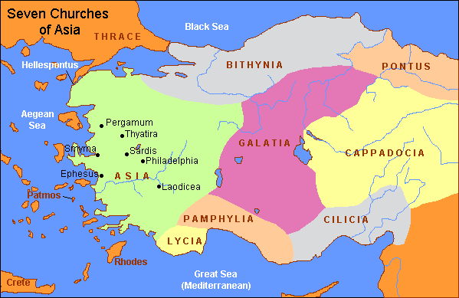

Slide 8
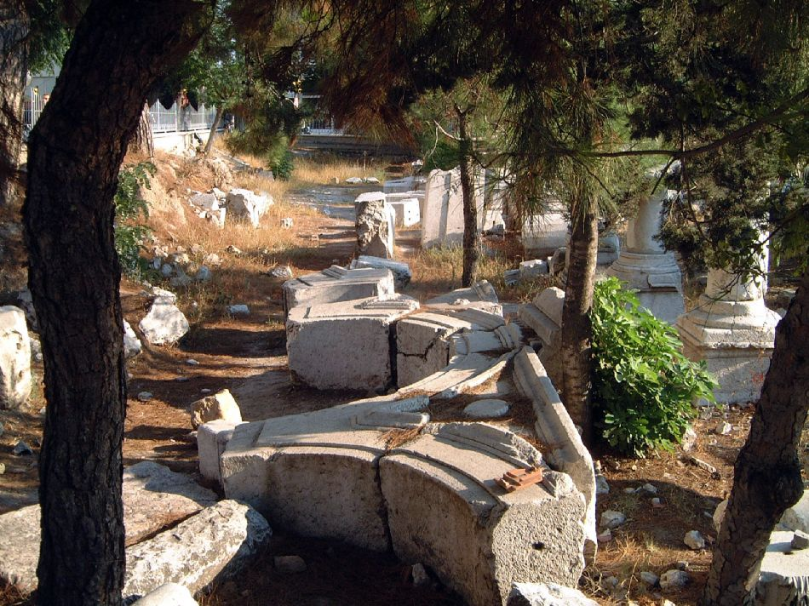
Thyatira was situated in a fertile valley through which trade routes passed. Although damaged by an earthquake during the reign of Augustus, Thyatira was rebuilt with Roman help.
(courtesy of www.holylandphotos.org)
Thyatira (modern Akhisar) has population of ~ 74,000

Slide 9
Revelation 2:18-29
A Tolerant Church
Revelation 2:18-29
The Messenger (verses 18, 23)
The Strength (verse 19)
The Weakness (verse 20)
The Warning (verses 21-23)
The Assurance (verses 24-29)

Slide 10
Revelation 2:18-29
A Tolerant Church
Revelation 2:18-29
The Messenger (verses 18, 23)

Slide 11
Revelation 2:18-29
The Messenger (verses 18, 23)
Son of God – deity, God, Judge (verse 18)
Eyes like a flame of fire (verse 18)
May refer to his anger when saw the problems
May refer to penetrating nature of his vision

Slide 12
Revelation 2:18-29
The Messenger (verses 18, 23)
Son of God – deity, God, Judge (verse 18)
Eyes like a flame of fire (verse 18)
Feet like fine brass (verse 18)
Firmness of his stand against sin and error
The beauty of his stand

Slide 13
Revelation 2:18-29
The Messenger (verses 18, 23)
Son of God – deity, God, Judge (verse 18)
Eyes like a flame of fire (verse 18)
Feet like fine brass (verse 18)
Searches the mind and heart (verse 23)
Knows all
Examines fully before judgment

Slide 14
Revelation 2:18-29
A Tolerant Church
Revelation 2:18-29
The Messenger (verses 18, 23)
The Strength (verse 19)

Slide 15
Revelation 2:18-29
The Strength (verse 19)
Works – Active, busy, doing, etc.
Love – For God, truth, others. Matthew 22:37-40
To love God means that one keeps His commandments. 1 John 5:3; John 14:15; 15:14
Service – Serving God and others (from love) 1 John 3:17-18; 4:20-21; Galatians 5:6; John 13:4-17
Faith – Belief, reaction to word, obedience Romans 10:17; James 2:14-24

Slide 16
Revelation 2:18-29
The Strength (verse 19)
Patience – Perseverance, steadfast. Romans 5:3-5; James 1:2-4; Hebrews 10:35-39
Last greater than first –
Grown, progressed.
Doing more now than had at first (often it is just the opposite).

Slide 17
Revelation 2:18-29
A Tolerant Church
Revelation 2:18-29
The Messenger (verses 18, 23)
The Strength (verse 19)
The Weakness (verse 20)

Slide 18
Revelation 2:18-29
The Weakness (verse 20)
Tolerant
“Notwithstanding I have a few things against thee …” KJV

Slide 19
Revelation 2:18-29
Jezebel
Revelation 2:20, “… that thou sufferest the woman Jezebel”
Wicked wife of wicked king Ahab (1 Kings 21:25)
Daughter of Ethbaal, king of the Sidonians, and a worshipper of Baal.
Supported 450 prophets of Baal. 1 Kings 18-19
Eaten by dogs. 1 Kings 21:23; 2 Kings 9:10; 2 Kings 9:33-35

Slide 20
Revelation 2:18-29
Jezebel
Revelation 2:20, “… that thou sufferest the woman Jezebel”
Here used symbolically like “Balaam” (2:14)
May refer to a faction within the church
May refer to a woman who had evil influence
Claimed to be a prophetess – but was not

Slide 21
Revelation 2:18-29
III. The Weakness (verse 20)
Tolerant
Jezebel was allowed (tolerated NASV)
Not doing so themselves – but tolerate it!
Could have been stopped – but nothing was done!
Condemned for not taking action! 2 Thessalonians 3:6; 1 Corinthians 5

Slide 22
Revelation 2:18-29
III. The Weakness (verse 20)
Tolerant
Jezebel was allowed
What was allowed
Teach Christians to commit adultery
Perhaps: by joining the trade guilds (with its sacrifices to idols) cf. 1 Corinthians 6, 8, and 10; Acts 15:20, 29
No evidence that they “just quit”

Slide 23
Revelation 2:18-29
“The woman (or faction) referred to as Jezebel had not quit the church at Thyatira, and was not encouraging others to quit the church … Many there are who would not think of quitting the church altogether, but who compromise with the devil on first one thing and then another.”
– Bobby Duncan, Spiritual Sword, 29:1, October 1997, Page 25

Slide 24
Revelation 2:18-29
III. The Weakness (verse 20)
Tolerant
Jezebel was allowed
What was allowed
Teach Christians to commit adultery
Perhaps: by joining the trade guilds (with its sacrifices to idols)
No evidence that they “just quit”
The church had allowed all this to happen!

Slide 25
Revelation 2:18-29
III. The Weakness (verse 20)
Tolerant
Jezebel was allowed
What was allowed
The church bore some responsibility
God held the church responsible for its members. We need the constant presence of others who will “reprove, rebuke, and exhort” (2 Timothy 4:2).
Blame is not just on Jezebel, but on the church! Philippians 2:15-16; 2 Corinthians 6:14-18; 3 John

Slide 26
Revelation 2:18-29
A Tolerant Church
Revelation 2:18-29
The Messenger (verses 18, 23)
The Strength (verse 19)
The Weakness (verse 20)

Slide 27
Revelation 2:18-29
A Tolerant Church
Revelation 2:18-29
IV. The Warning (verses 21-23) Revelation 2:22-23, “Behold, I cast her into a bed, and them that commit adultery with her into great tribulation, except they repent of her works. And I will kill her children with death; and all the churches shall know that I am he that searcheth the reins and hearts: and I will give unto each one of you according to your works.”

Slide 28
Revelation 2:18-29
The Warning (verses 21-23)
Rejected opportunities and refused to repent (verse 21)
Faces judgment (verse 23); just and certain 2 Corinthians 5:10; Romans 2:6; 14:10-12
Punishment (verses 22-23)
Sickbed
Tribulation
Kill children with death
The choice was theirs (verse 22) Galatians 6:7-8; Hebrews 13:4

